Slide 1
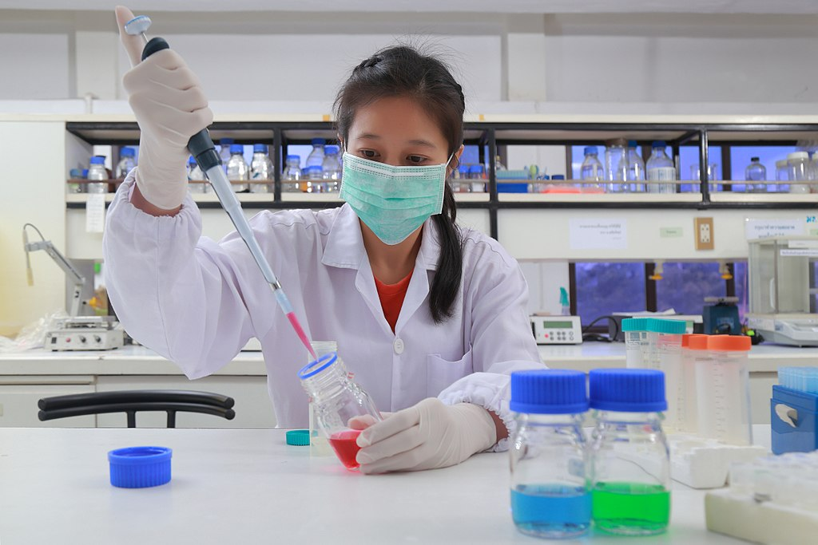
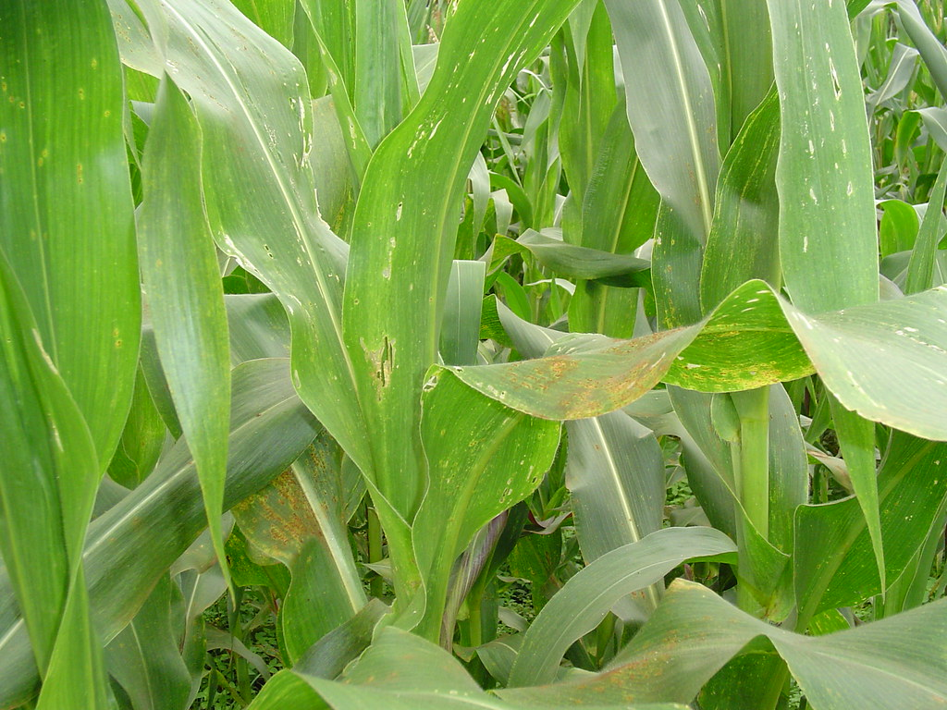
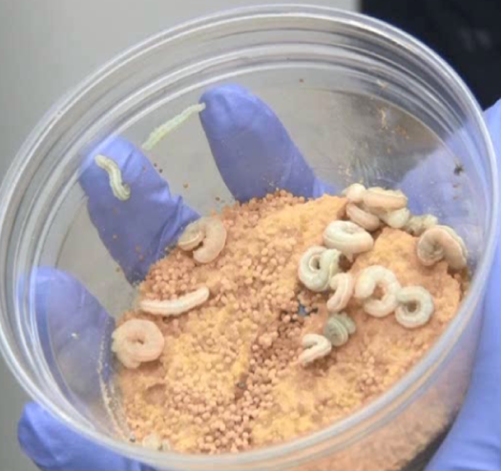
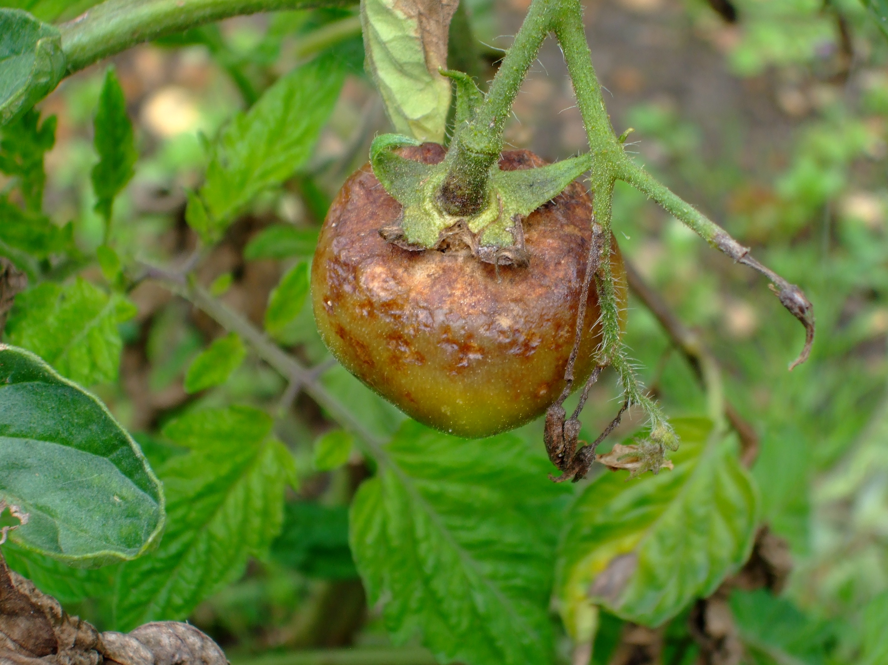
BIOCONTROL RESEARCH MASTERCLASS SERIES Part 1: 26 May 2022: Introductions, Efficacy, Trial Design www.aseanfawaction.org
This series is supported by

Slide 2
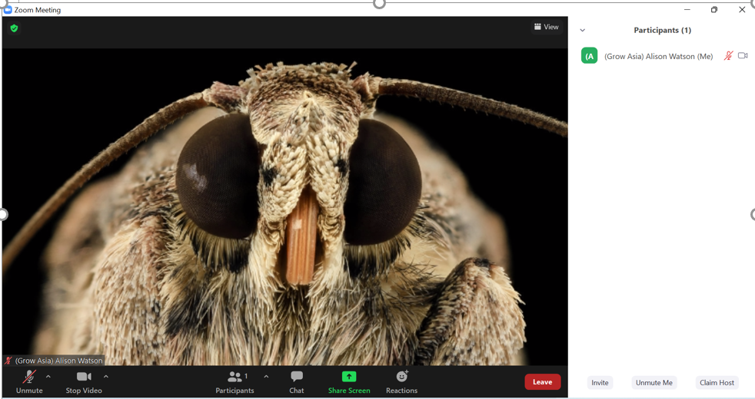
The session will be recorded
Technical issues:
Try logging off and on
Send a message to us in the Chat
2. Rename yourself by clicking participants then clicking your name and clicking “More”.
3. Use the Reactions box
(raise your hand if you wish to speak)
1. Use the chat box to ask questions, share thoughts & resources, introduce yourself.
Notes:
A few housekeeping points before we start. We will record the session – but we won’t make it public. The recording helps keep a record of the conversation and really assists me in writing up the notes for the meeting. Please stay on mute if you are not speaking. Use the chat box often to communicate and share your ideas and use the reactions to express your thoughts on anything. If you can take the time to rename yourself that would also be most helpful by going to Participants, clicking that and then clicking your name and pressing more where you will be able to rename yourself (please provide your country or organisation and name). Raise the hand on the reactions button if you wish to speak.

Slide 3
Welcome
Please introduce yourself in the chat
Name, what organization you are from, the country where you are based, and anything else of interest you wish to share!
Today we are not using Q & A and we encourage you to use the chat to get the conversation going and ask questions

Slide 4
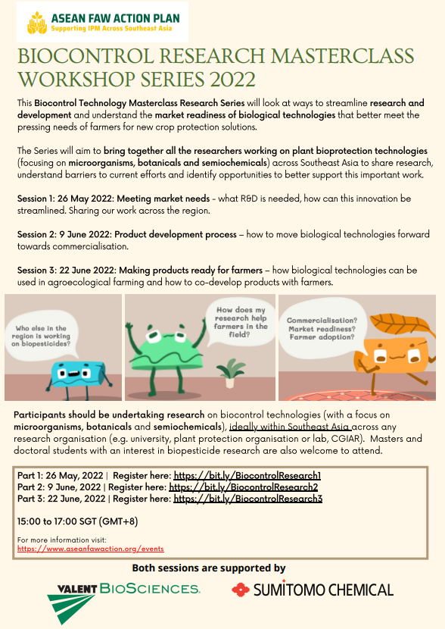
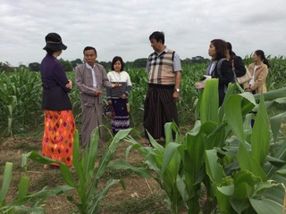
Schedule
Part 1: 26 May 2022
Part 2: 9 June 2022
Part 3: 22 June 2022
15:00 to 17:00 SGT (GMT+8)

Slide 5
BIOCONTROL RESEARCH MASTERCLASS SERIES Part 1: 26 May 2022 - Completed Part 2: Thursday 9 June 2022 www.aseanfawaction.org alisonwatson@growasia.org
CLOSE
This series is supported by

